Slide 1

Async/await
Asynchronous programming
Lecturer
Rokas Slaboševičius
Data

Slide 2
Today you will learn
Lecture title
What is asynchronous programming?
01
Async/await keywords
02

Slide 3
What is asynchronous/parallel programming?
Async/await
Asynchronous programming
Imagine that you want to do a task 100 times, each task takes on average 2 seconds.
It will take you about 200 seconds on average to complete the cycle 100 times.
What if it were possible to run all the tasks at the same time, so that they run parallel to each other?
This would take on average 2 seconds and is called asynchronous/parallel programming.

Slide 4
Why? Real world example
Async/await
Asynchronous programming
These concerns are important for the programs you write today. When you write client programs, you want the UI to be responsive to user input. Your application shouldn't make a phone appear frozen while it's downloading data from the web. When you write server programs, you don't want threads blocked. Those threads could be serving other requests. Using synchronous code when asynchronous alternatives exist hurts your ability to scale out less expensively. You pay for those blocked threads.
Successful modern applications require asynchronous code. Without language support, writing asynchronous code required callbacks, completion events, or other means that obscured the original intent of the code. The advantage of the synchronous code is that its step-by-step actions make it easy to scan and understand. Traditional asynchronous models forced you to focus on the asynchronous nature of the code, not on the fundamental actions of the code.

Slide 5
Example of breakfast preparation
Async/await
Asynchronous programming
We will start with a synchronous example and convert it into an asynchronous one.
A good example of asynchronous programming is cooking. Let's imagine that one person (equivalent to one Thread) cooks the food. Usually people cook asynchronously - they leave the water boiling, start chopping vegetables, turn on the oven to heat up, etc.
At the start of each process, you start a new Task and turn your attention to those Tasks that are already finishing their processes.
This example is asynchronous, but it is not parallel because only one person (Thread) is doing it.
To create a parallel programme, we would need several people to do the work asynchronously, and then the work would be parallel.

Slide 6
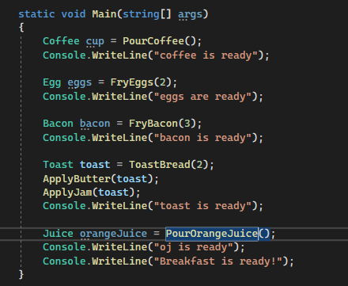
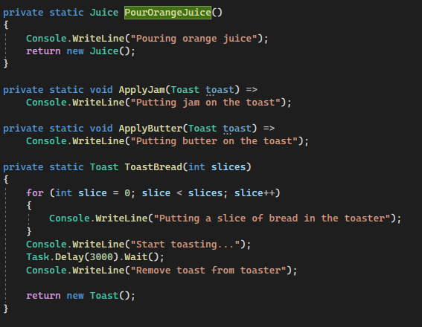
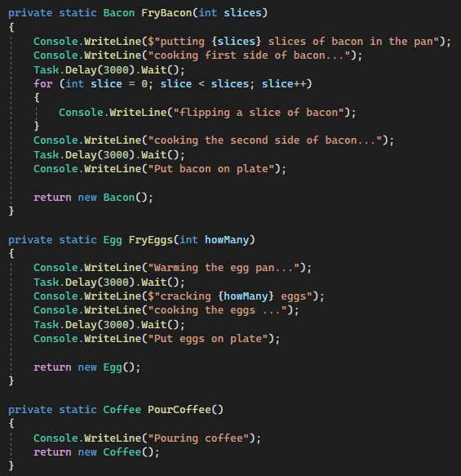
Example of breakfast preparation
Async/await
Asynchronous programming
Let's start with the synchronous programme.
This is a very simple app with
empty classrooms

Slide 7
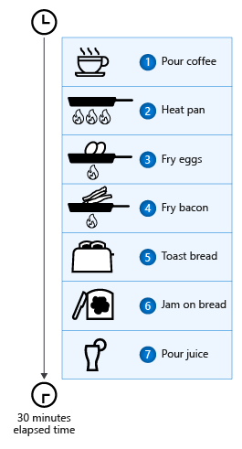
Example of breakfast preparation
Async/await
Asynchronous programming
As the tasks were done one after the other, it took 30 minutes.
We try to make the code asynchronous.

Slide 8

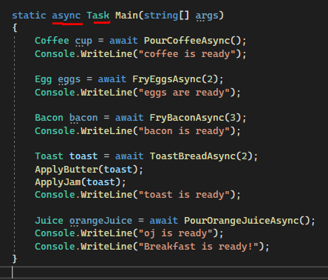
Example of breakfast preparation
Async/await
Asynchronous programming
As the tasks were done one after the other, it took 30 seconds.
We try to make the code asynchronous.
The first step is to make the calling methods asynchronous.
Methods from which async methods are called must also be async and return Task
You can also see that new methods like "FryEggsAsync" are called
now has the keyword await before the title, which means it would be received until the method finishes, but it does not block the main application Thread.

Slide 9
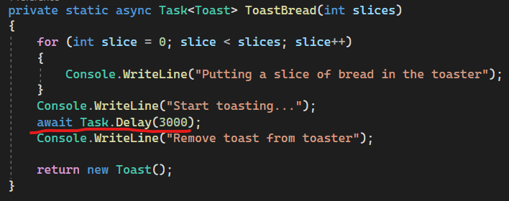
Example of breakfast preparation
Async/await
Asynchronous programming
When converting methods to asynchronous, change the delay methods from Task.Delay(3000).Wait() to await Task.Delay(3000) so that
to avoid blocking the main process.

Slide 10
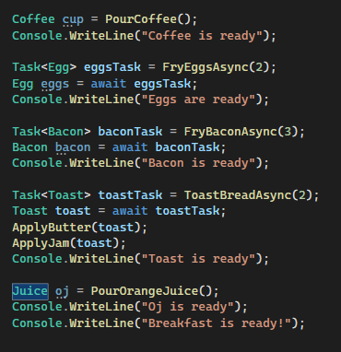
Example of breakfast preparation
Async/await
Asynchronous programming
Currently the application runs the asynchronous methods on a separate thread and doesn't block the application, but it waits for each one to finish anyway
Next change to put methods in Task objects

Slide 11
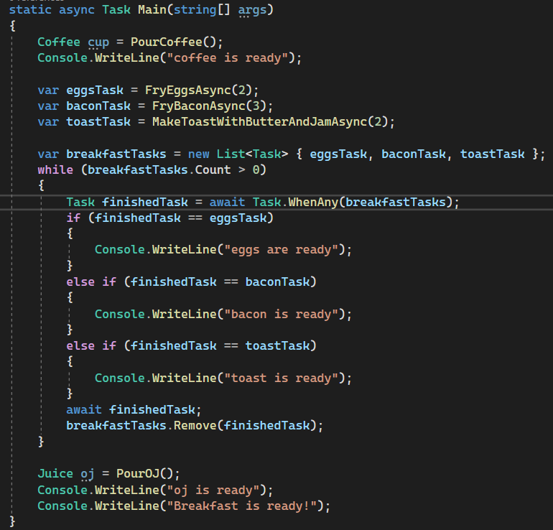
Example of breakfast preparation
Async/await
Asynchronous programming
It is now possible to move the addition of bacon and eggs to the end of the method.
In this way, the methods will begin to evolve, but we will take the result
later creating Toast, Juice, Egg and Bacon objects.
https://learn.microsoft.com/en-us/dotnet/csharp/asynchronous-programming/

Slide 12
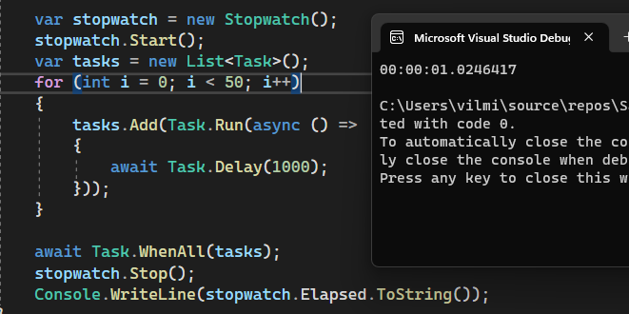
Example of breakfast preparation
Async/await
Asynchronous programming
The simplest check is to run the 50 Task objects
and checking how long it took to execute everything.

Slide 13

Async/await
Asynchronous programming
Task 1
Create a class ProgressBar that has an int field progress. The main method of your applet should create an object of type ProgressBar and execute a loop that increments the value of the progress field by one every second until the value reaches 100. Create another thread that outputs the value of the ProgressBar object, the progress field, to the console every 3 seconds for as long as the program runs.

Slide 14
Async/await
Asynchronous programming
Task 2
Create a program that prints the contents of your user's Desktop directory to the command line every 5 seconds after it is run.

Slide 15
Async/await
Asynchronous programming
async/await
https://docs.microsoft.com/en-us/dotnet/csharp/programming-guide/concepts/async/
Useful information

